Slide 1
Nutrition Basics
Chapter 12

Slide 2
Nutrition Basics
Objectives
Vocabulary
Relate earlier scientific findings to today’s understanding of nutrition.
Identify and briefly describe essential nutrients.
Relate the understanding of nutrition to physical well-being.
Essential nutrients
Nutrient dense
Nutrients
Nutrition
Recommended Dietary Allowances (RDAs)
scurvy

Slide 3
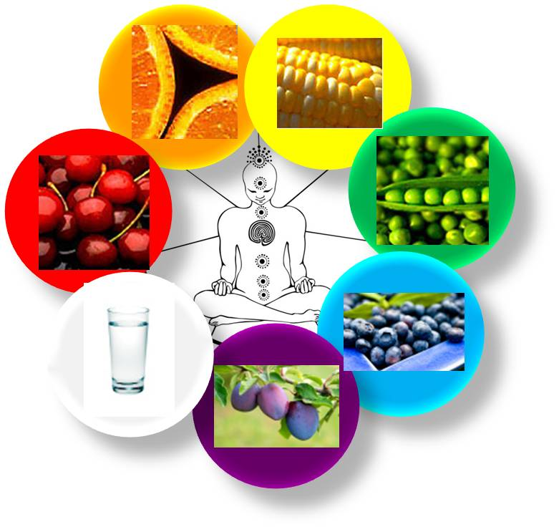
Nutrition History Highlights
Ancient people credited food for having magical powers
Around 400 B.C., Hippocrates, “the father of modern medicine,” taught that people could learn what was good for them by reasoning from observable facts
Studies led him to believe that foods contain life-giving substance
Not until the mid 1700’s that the scientific method proved him right

Slide 4
An Early Discovery
British sailors suffered from lack of Vitamin C, which caused circulatory disease, bleeding gums, weakened blood vessels, and extreme fatigue. This was also fatal.
The name for this condition was scurvy.
A physician set up an experiment to find a cure and the illness only disappeared in the sailors that ate lemons and limes.
This experiment gave the sailors a nickname called limeys, which is applied to British citizens today.
Notes:
In 1740, a physician set out to find a cure. He chose a group of twelve British sailors who had the illness to eat a variety of foods, including limes, lemons, cider, vinegar, seawater , nutmeg, an oil of vitriol.

Slide 5
Nutrition
The science of how the body uses food

Slide 6
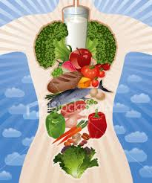
Nutrients
Are the materials for the building and maintenance of the body tissue, and regulate body processes.
The body needs the correct amounts of specific nutrients from 6 categories.
Each one of these nutrients performs specific functions in the body.

Slide 7
6 Classes of Nutrients
Carbohydrates | Proteins | Fats
Water | Vitamins | Minerals

Slide 8
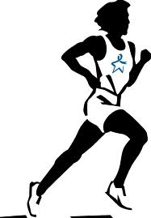
Calories
1 gm
Carbs
= 4 kcal
1 gm
Protein
= 4 kcal
1 gm
Fat
= 9 kcal
Three nutrients give us ENERGY or “fuel for the body”.
A unit of ENERGY is called a CALORIE (kcal)
Notice that fat is double the calories per gram

Slide 9
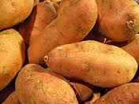
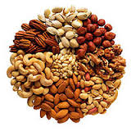
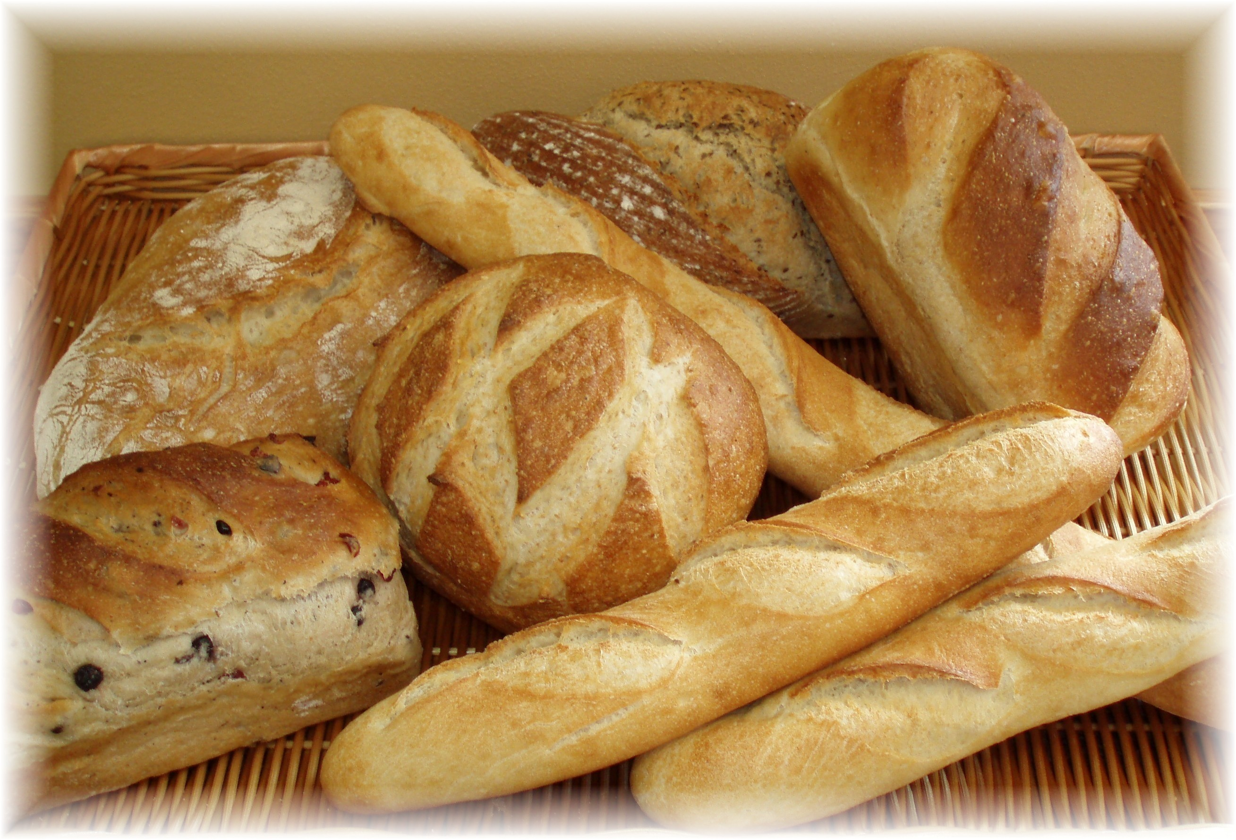
Carbohydrates
Best Sources
Bread
Cereals
Fruits
Potatoes
Rice
Sweets
chips
sugar
Benefits for the Body
Body’s main source of energy
Provides fiber for digestion & elimination

Slide 10
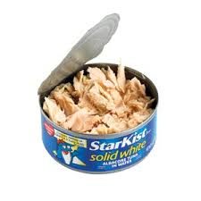
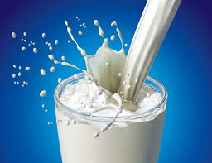
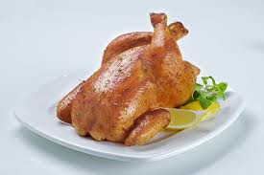
Proteins
Best Sources
Meat
Poultry
Fish
Legumes
Nuts
Milk
Cheese
Eggs
Benefits for the Body
Build and repair tissue
Help regulate body processes
Help make antibodies to fight disease

Slide 11
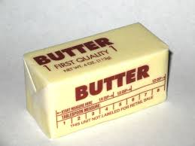
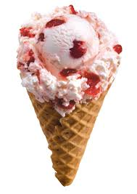
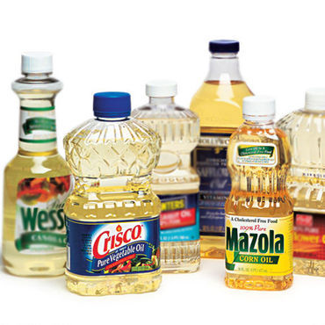
Fats
Best Sources
olive oil
canola oil
vegetable oil
avacados
nuts
Benefits for the Body
Carry fat-soluble vitamins through the body
Some supply essential fatty acids for normal growth and skin health

Slide 12
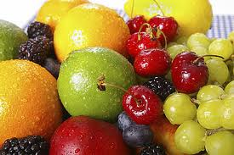
Vitamins
Best Sources
Different in all foods
Benefits for the Body
Each vitamin has it’s special function.
They help regulate body processes

Slide 13
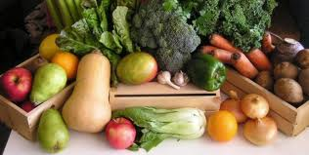
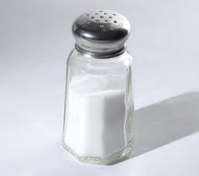
Minerals
Best Sources
Different in all foods
Benefits for the body
Help regulate body processes

Slide 14
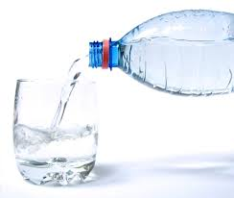
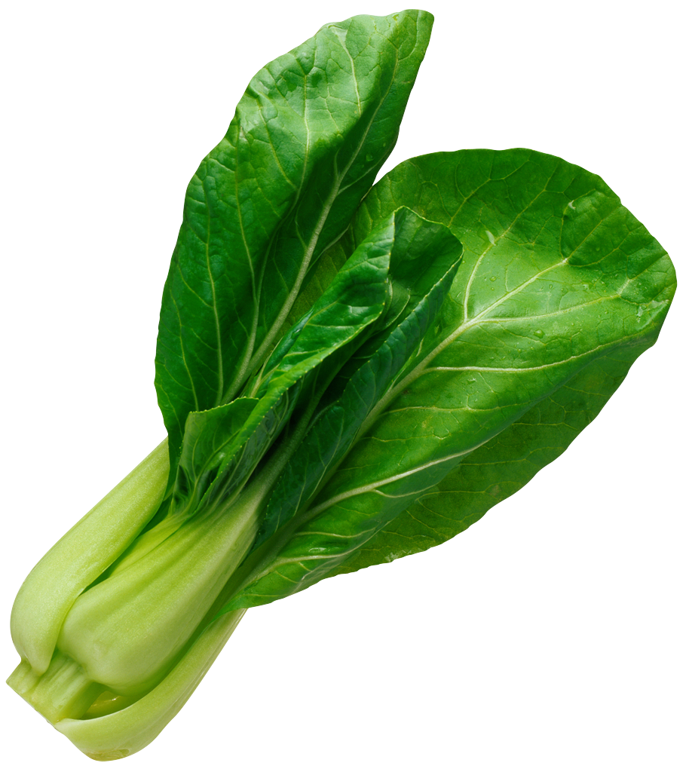
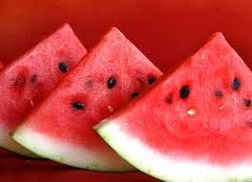
Water
Best Sources
Water
Fruits
Vegetables
Benefits for the Body
Carries nutrients to the body cells.
Carries waste products away.
Helps keep the body cool.

Slide 15
Variables which affect nutrient needs:
1. Age
2. Gender
3. Activity Level
4. Climate
5. Health
6. State of nutrition

Slide 16
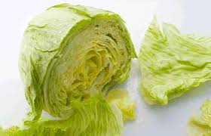
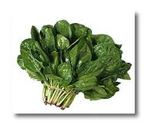
Nutrient Dense
Nutrient dense food supply many nutrients that are critical to good health in comparison to their low-to-moderate number of calories.

Slide 17
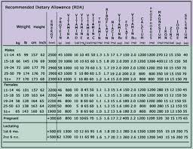
RDA’s
(RDA) Recommended Dietary Allowances – Is a table supplied by the US government to give adequate amounts of specific nutrients needed by most healthy people.
First established over fifty years ago.
Supplies a detailed description of nutrient needs of eighteen population groups.
Currently covers protein, ten vitamins and seven minerals
Notes:
Pass around packets of the RDA’s for students to look at.

Slide 18
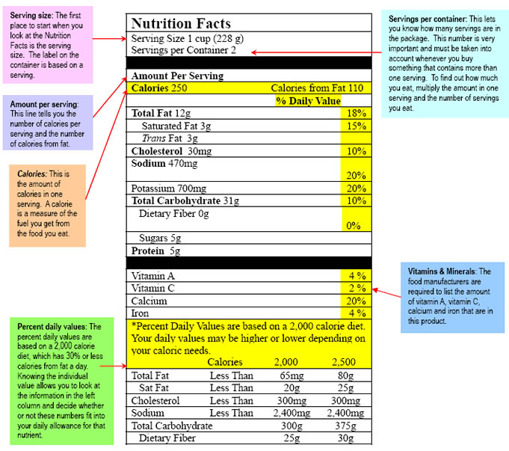
Food Labeling

